Slide 1



NBA Rookie Analysis by
Veteran Data Analysts

Slide 2




Boring Stuff (The First Chapter)
BALLDONTLIE API
Upload to S3 Bucket
Sagemaker
Provided historical data from 1979 to present.
Scheduled Glue Jobs to update on a nightly basis at 12AM PST
Glue job is scheduled to run every night at midnight.
New data is concatenated into our file in S3 bucket.
Used to fit the model on the different stats available for each player to help us predict ROTY.

Slide 3
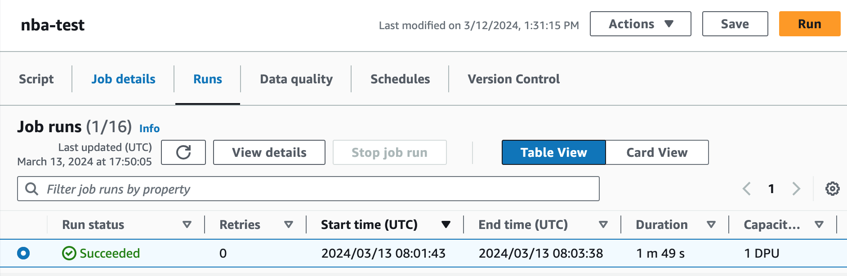
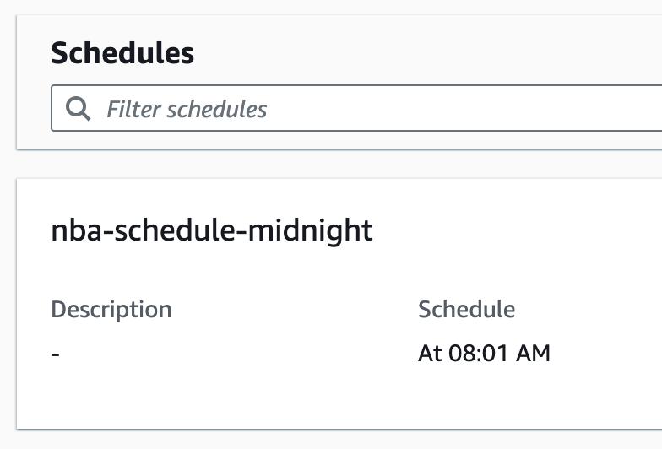
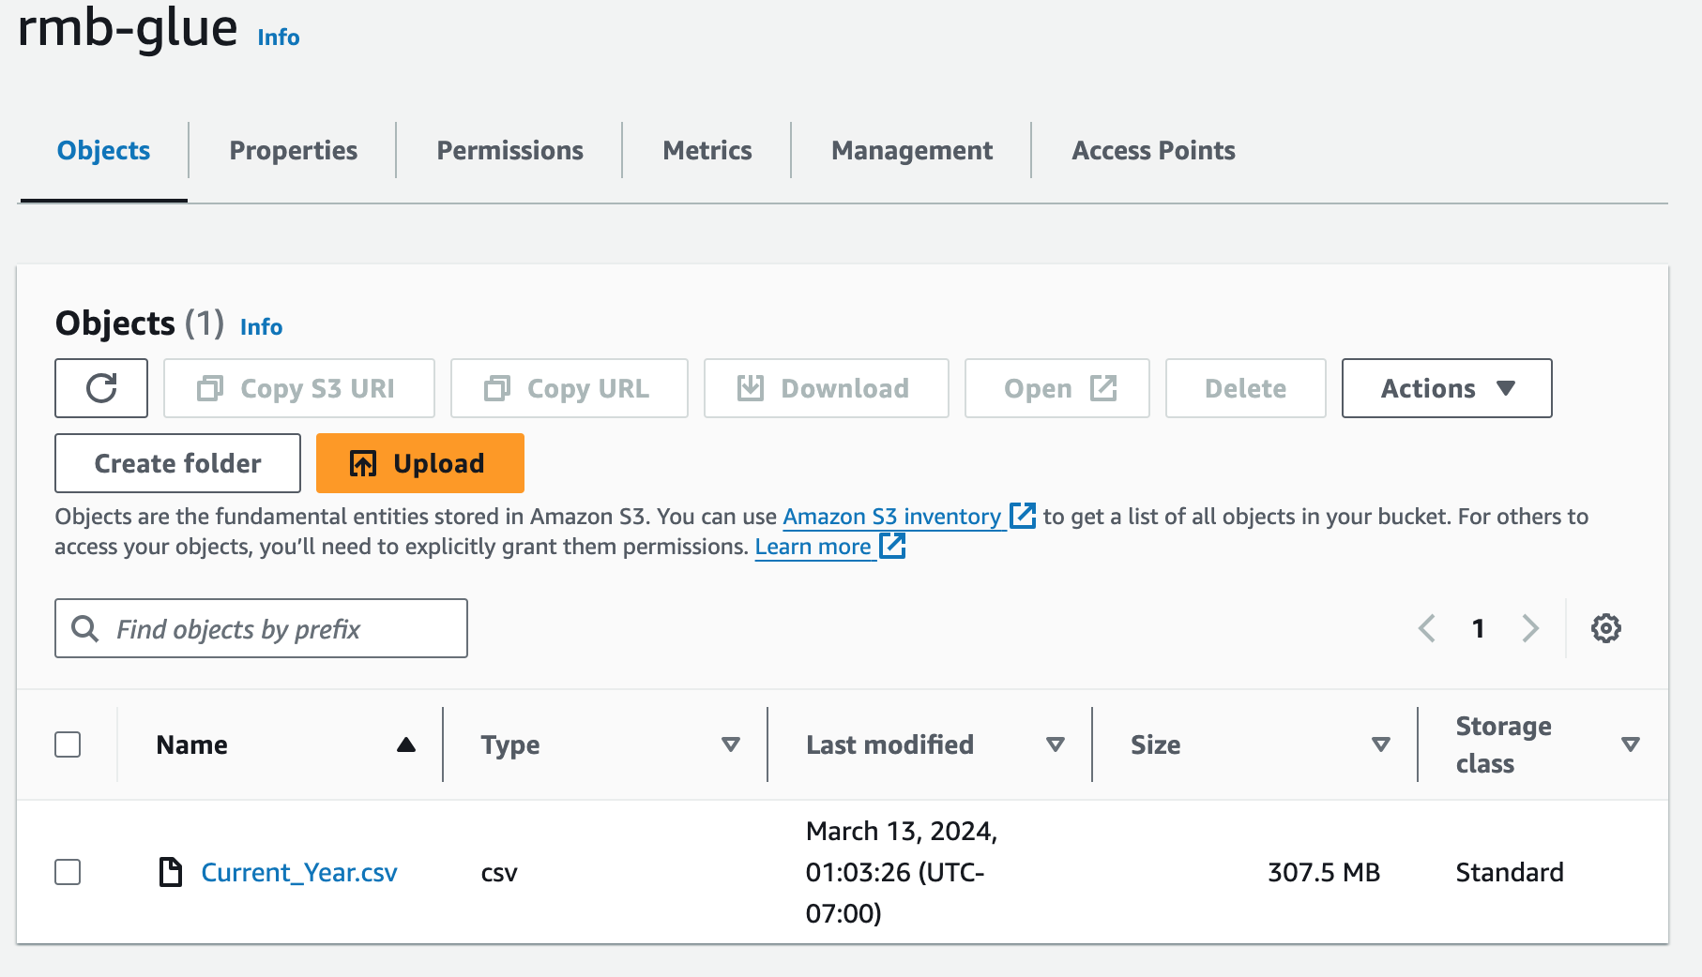
Boring Stuff (The End)

Slide 4
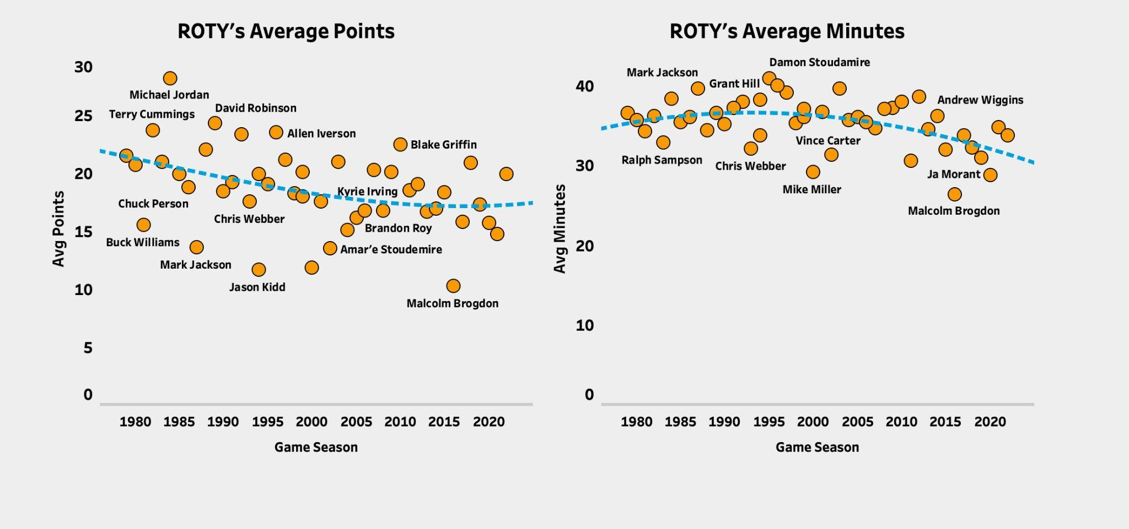

NBA Rookies Over Time - Points & Minutes
Decline in Average Points, likely due to increase in defensive talent across the league.
Players opt to defer more as they trust their teammates to handle the scoring burden. They gap in skill has drastically closed, making obvious outliers (star’s) less frequent.
In terms of minutes played, rookies who go on to win ROTY play a significant role and command playing time (<30)
Downward trend can be explained by player longevity protocols (min restrictions) which are more prominent in today’s game

Slide 5
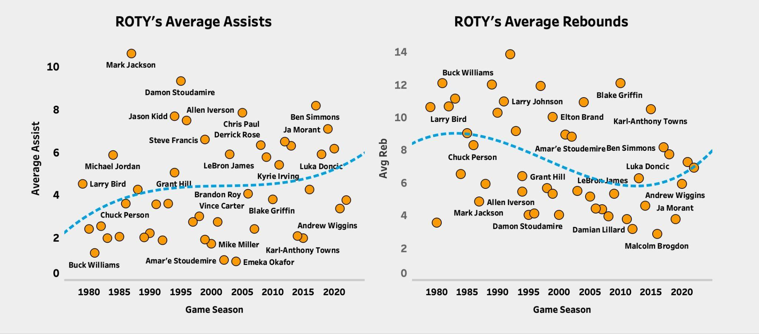
Assists & Rebounds
Rookie players, on average, facilitate game play more in recent years
Variance in assists has reduced over time due to new trend of positionless basketball
Younger players size and physicality are matching older players as the years go on
Wemby Rookie height: 7’4” , Zion: Rookie weight: 284 lbs

Slide 6
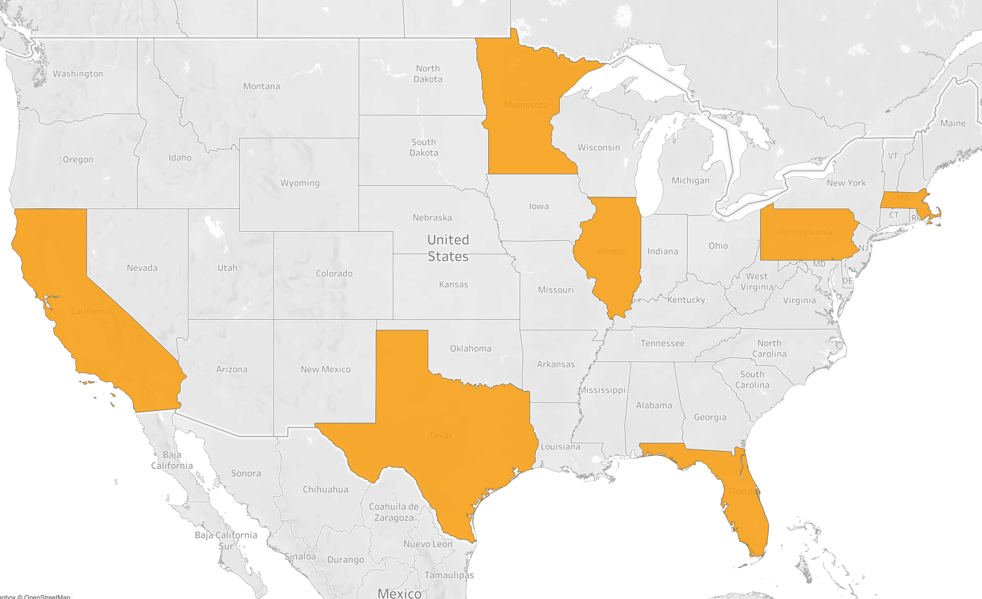







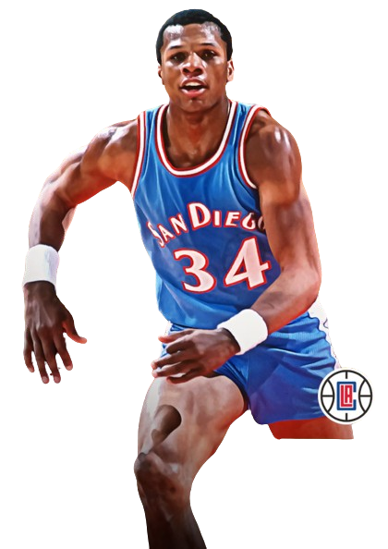



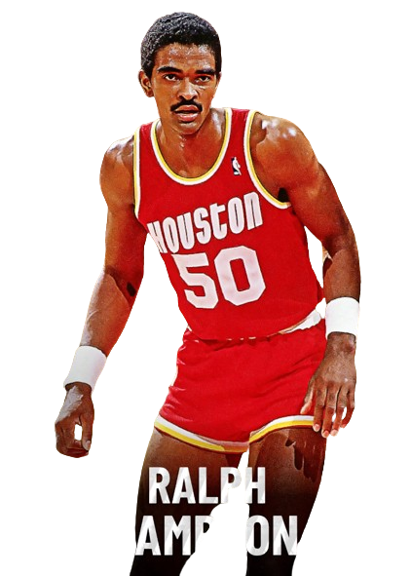
Top 10 Most Efficient ROTY
All Time
Year Key
MIN - F
#7
- Before 2000
Karl-Anthony
Towns
#8
- After 2000
18.3 PPG
Ben Simmons
PHI - F
GSW - PF
#5
CHI - SG/SF
Chris Webber
BOS - SF
#2
15.8 PPG
17.5 PPG
SDC - PF
Michael Jordan
28.2 PPG
#6
21.5 PPG
#9
DAL - G/F
Larry Bird m
Luka a
Doncic
23.7 PPG
#3
SAS - C
ORL - C
20.9 PPG
#4
Terry Cummings
Position Key
PG - Point Guard
SG - Shooting Guard
SF - Small Forward
PF - Power Forward
C - Center
#1
HOU - PF/C
Shaquille O’Neal
24.3 PPG
#10
23.37 PPG
David Robinson
Ralph aa
Sampson
21.0 PPG

Slide 7

Can we build a Model to Predict ROTY?
Model: SGD Classifier
Stochastic Gradient Descent using log loss function to find ROTY probabilities
Online Learning Capabilities: Great for data that is evolving at a rapid pace (daily in our case)
Predictors (all Average Stats):
Games Played
PER, Pts, Asts, Rebs, Blks, Mins, FGM, FGA, FG3M, FG3A, Turn &
Games Played

Slide 8

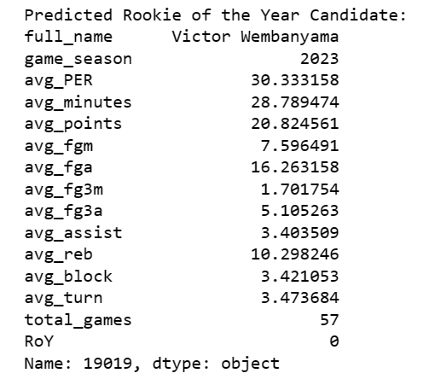
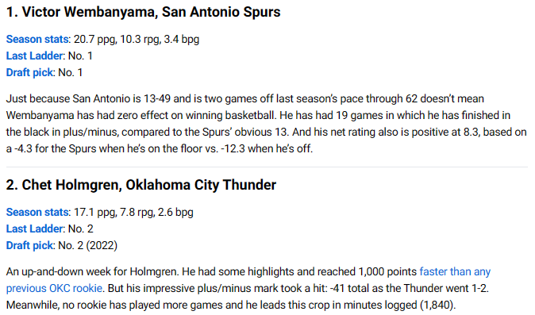

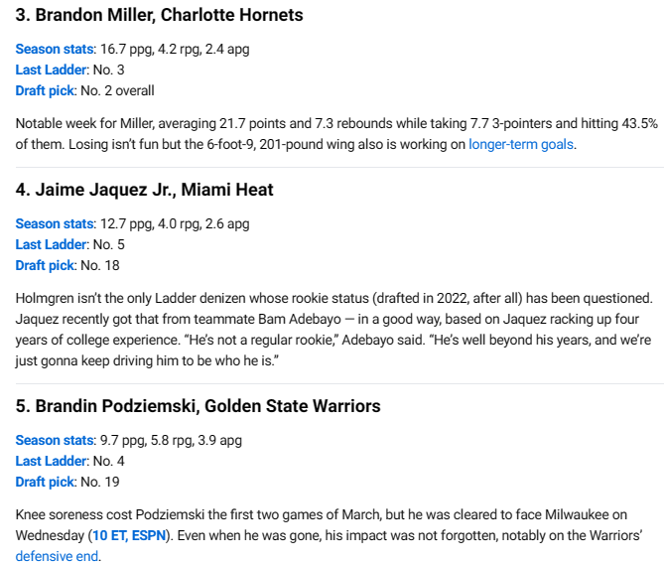
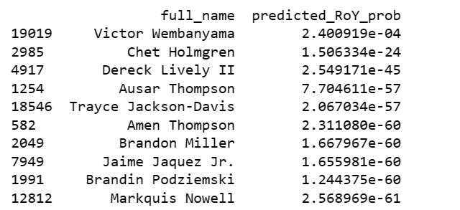
ROTY Model Results
ROTY Prediction: WEMBYYYYYYY
Current ESPN ROTY Projections
Ranked ROTY projections based on probabilities

Slide 9
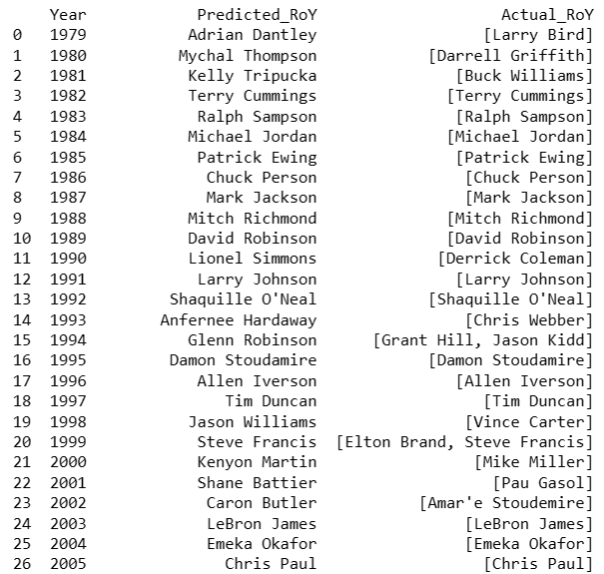
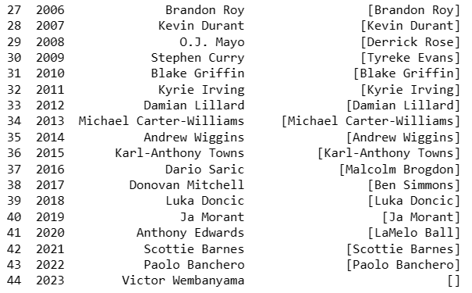
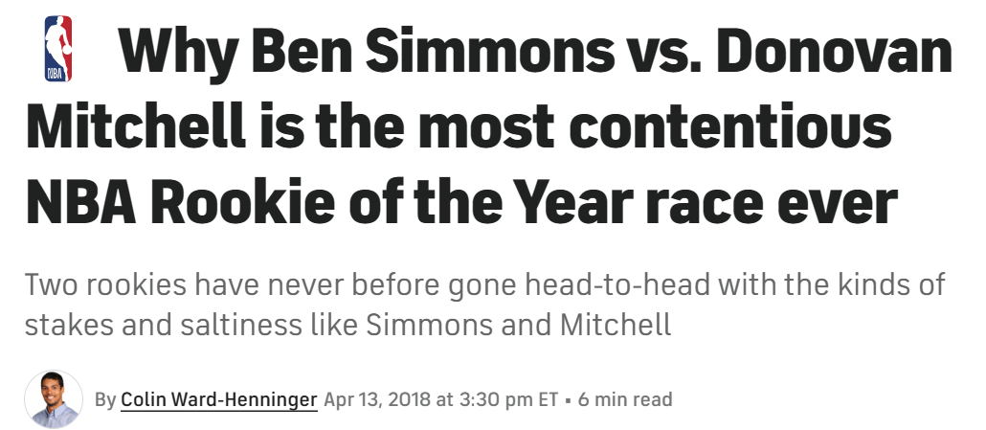
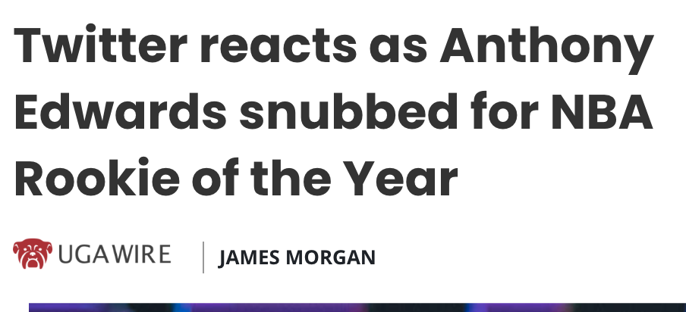
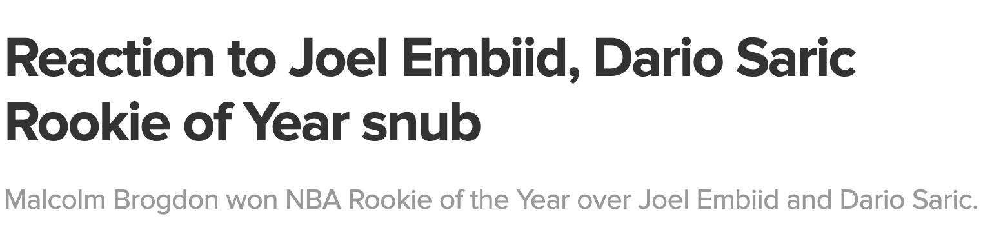
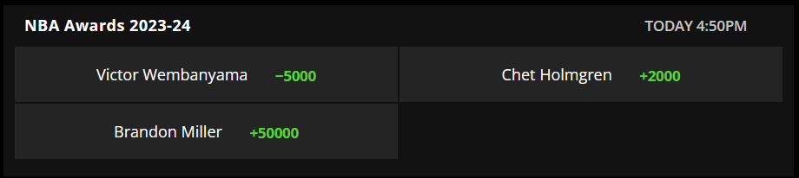
Model Accuracy Over Time
✅
✅
✅
✅
✅
✅
✅
✅
✅
✅
✅
✅
✅
✅
✅
✅
✅
✅
✅
✅
✅
✅
✅
✅
✅
✅
70% Prediction Accuracy
✅
✅
✅
Draftkings Odds

Slide 10

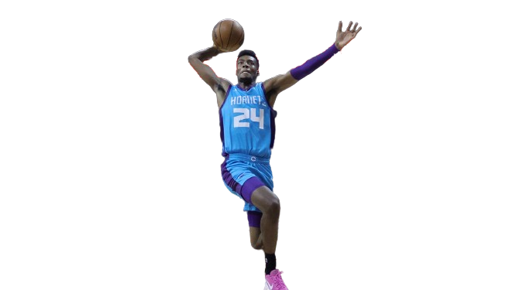
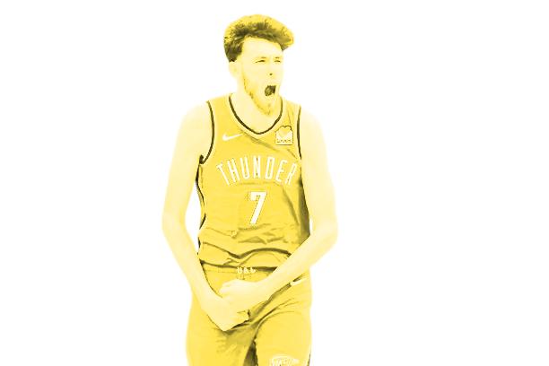
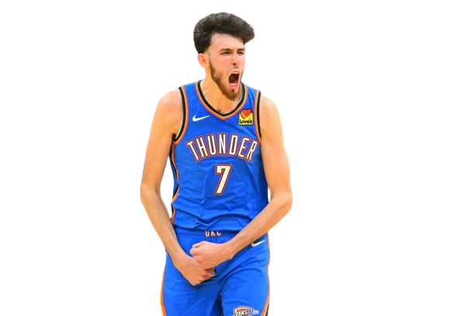
THANKS!
Real-Time Rookie of the year Projections

